Slide 1






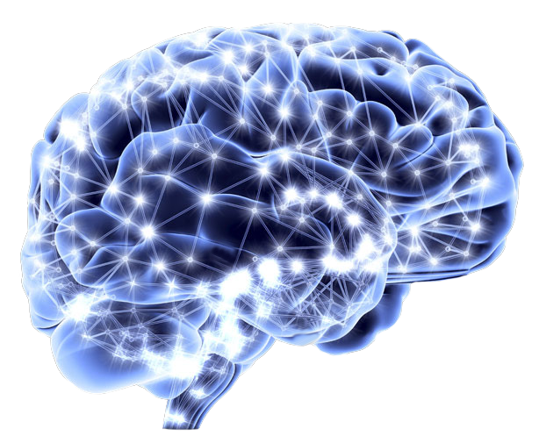

NEURAL SEARCH
System For University

Slide 2



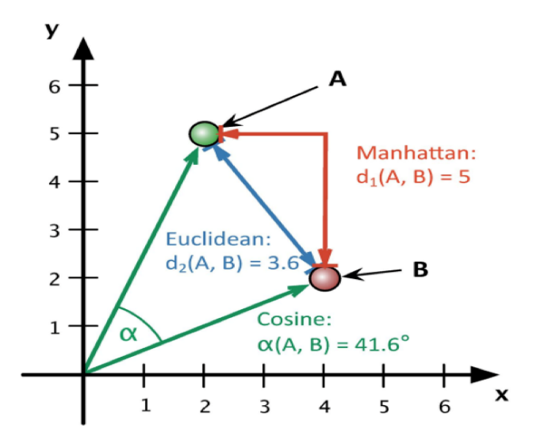



What is
Neural search?
Neural search
Neural search is a smarter way of searching for information. It uses artificial intelligence models inspired by the human brain to understand the meaning behind search queries and deliver more relevant results.
Key features
AI-based search technology
Understands query meanings
Analyzes context and user intent
Delivers personalized results
Improves search accuracy

Slide 3
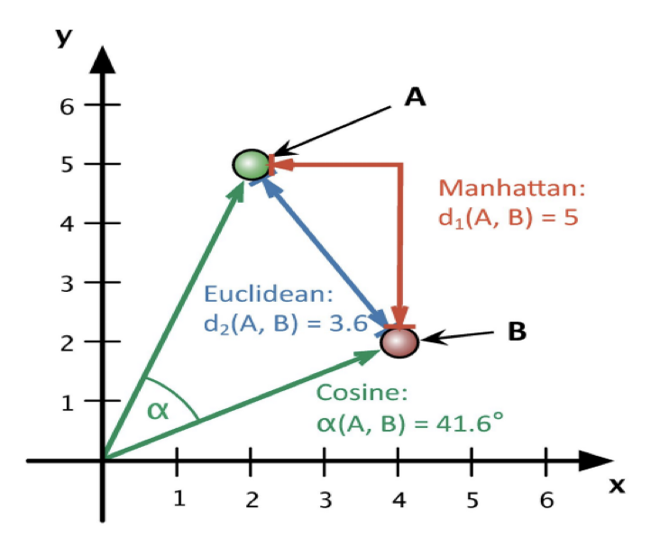





What is
Neural search?
Working of Neural Search
Neural Search works with embeddings, the section describes embeddings
Embeddings are generated by neural network model which will translate a text into a numerical vector
From sentence_transformers import SentenceTransformer

Slide 4



Challenges in
Website Data Search
Explanation
Imagine you're looking for something specific on your university's website, like information about a particular course or event. Neural search helps you find it faster and more accurately by using smart computer programs that understand what you're looking for and where to find it.

Slide 5
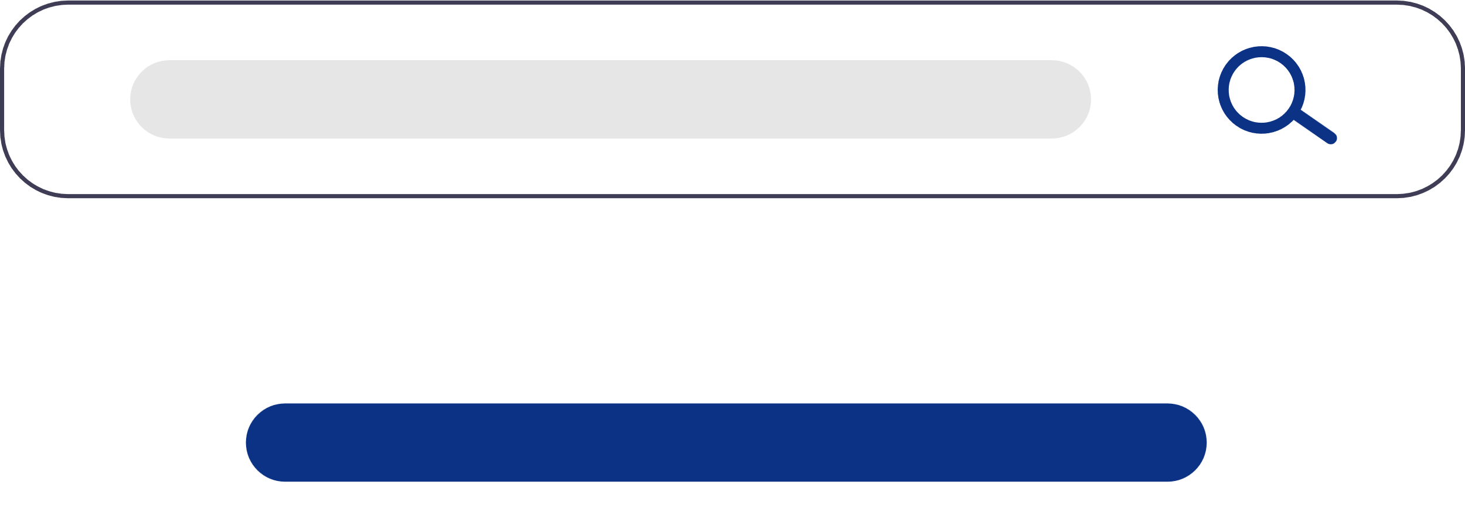
Challenges in
Website Data Search
Explanation
University websites are like treasure troves full of all kinds of information, from class schedules to research papers. But sorting through all that information can be tough because people search for things in different ways, and the website might not always understand what you're asking for.

Slide 6



Slide 7

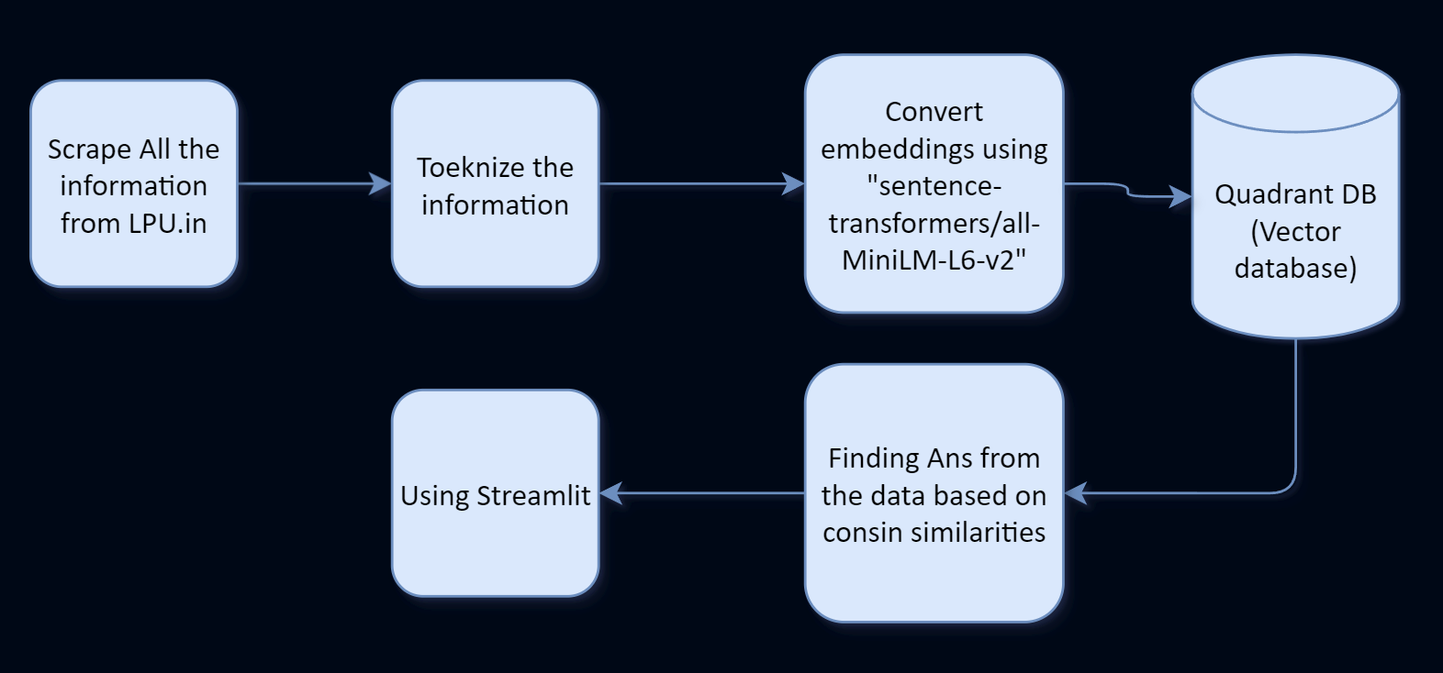


How UniBot Works?

Slide 8




Install Required Packages
Python Libraries
Sentence-transformers – ( Converting Text to Numbers )
qdrant-client – ( Database )
Langchain – ( Text Processing )
Beautifulsoup – ( Scraping )
Lxml – ( Parsing XML/HTML )
Streamlit – ( Web applications )

Slide 9


Future Enhancement
Utilizing GPU: will enhance the efficiency and performance of our project.
Token length: refers to the number of characters, including spaces and punctuation, in a single unit of text usually separated by spaces
Text preprocessing: is the initial step of cleaning and transforming raw text data into a format suitable for further natural language processing tasks.
Fine-tuning: an open-source LLM like Llama3.0 involves adapting its pre-trained parameters on a specific dataset or task to enhance its performance for a particular application.

Slide 10
Thank
You

